Slide 1


Introduction to
CSS3

Slide 2
What is CSS?
CSS stands for Cascading Style Sheets.
CSS defines how HTML elements are to be displayed. In other words it helps to format and add styles to HTML elements.
CSS is used to design the web page layouts and how these layouts appear on different screens.

Slide 3
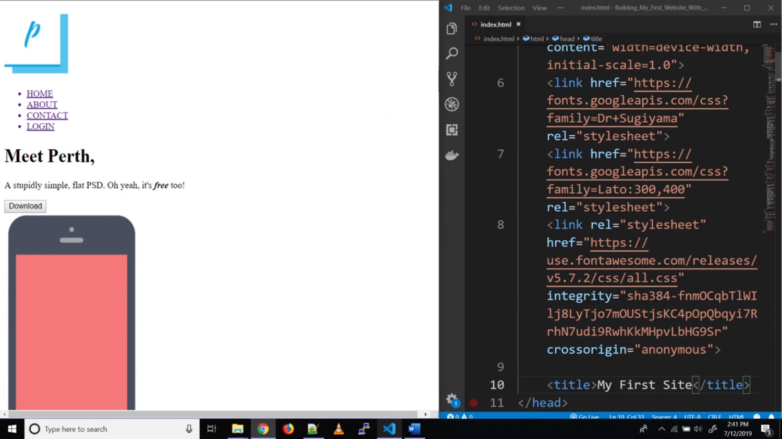

Slide 4
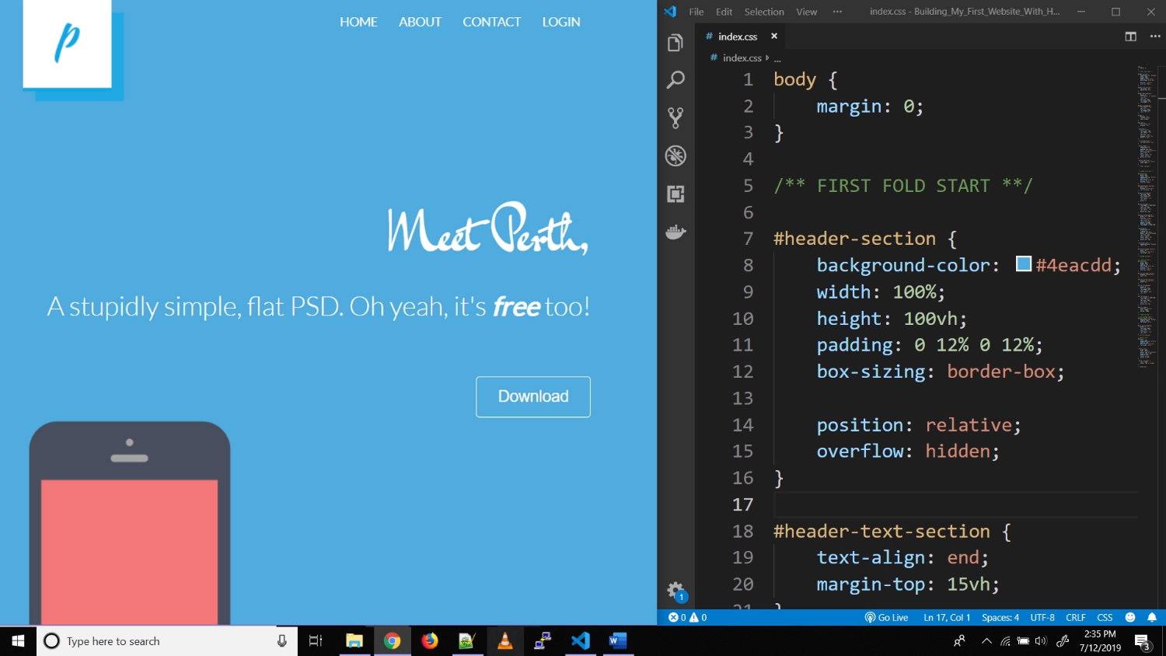

Slide 5
SYNTAX

Slide 6
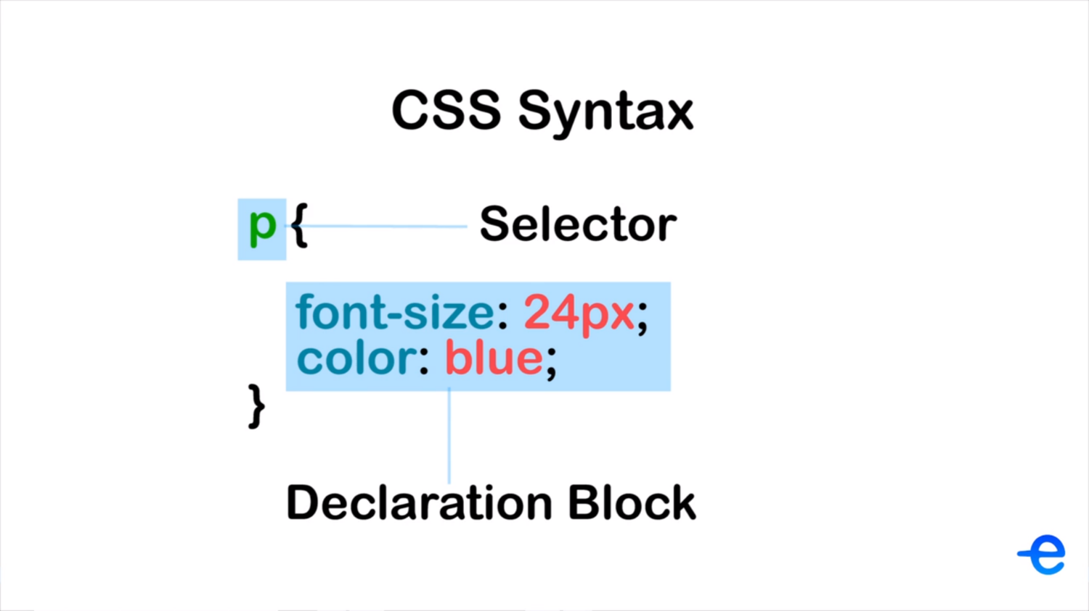

Slide 7
WAYS TO ADD STYLES

Slide 8
Different ways to add styles!!
Inline Styles
Internal Styles
External Styles
Priority:
Inline Styles > Internal Styles > External Styles
NOTE: The sequence also matters.

Slide 9
MODULES IN CSS3

Slide 10
Modules in CSS3
Selectors
Box Model
Backgrounds and Borders
Image Values and Replaced Content
Text Effects
2D/3D Transformations
Animations
Multiple Column Layout
User Interface

Slide 11
SELECTORS

Slide 12
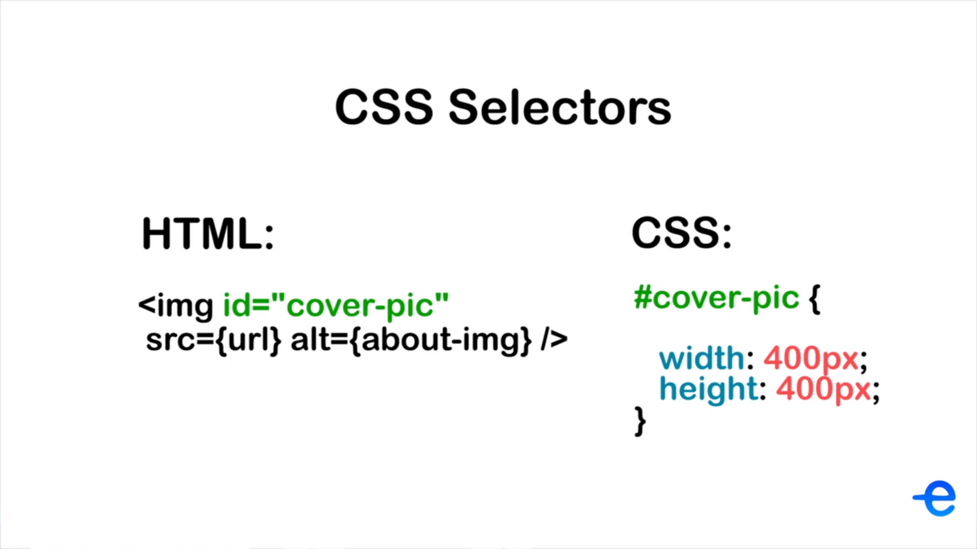

Slide 13
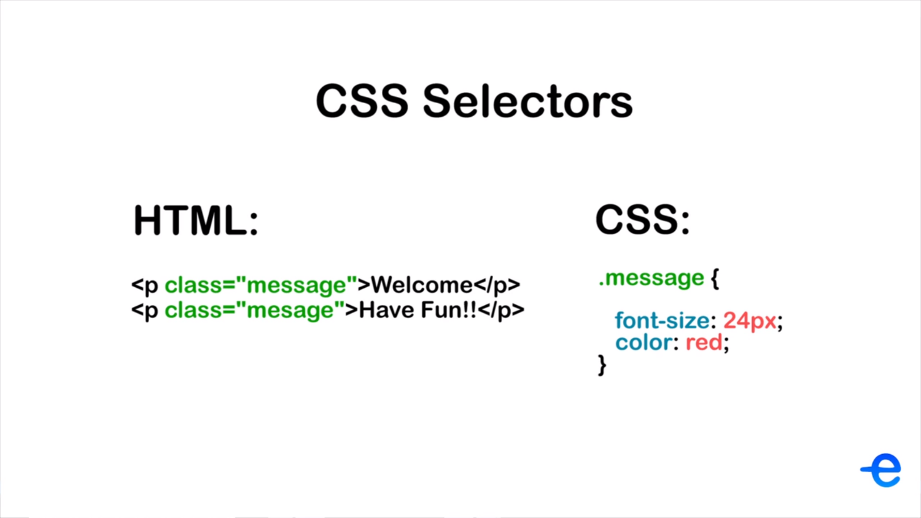

Slide 14
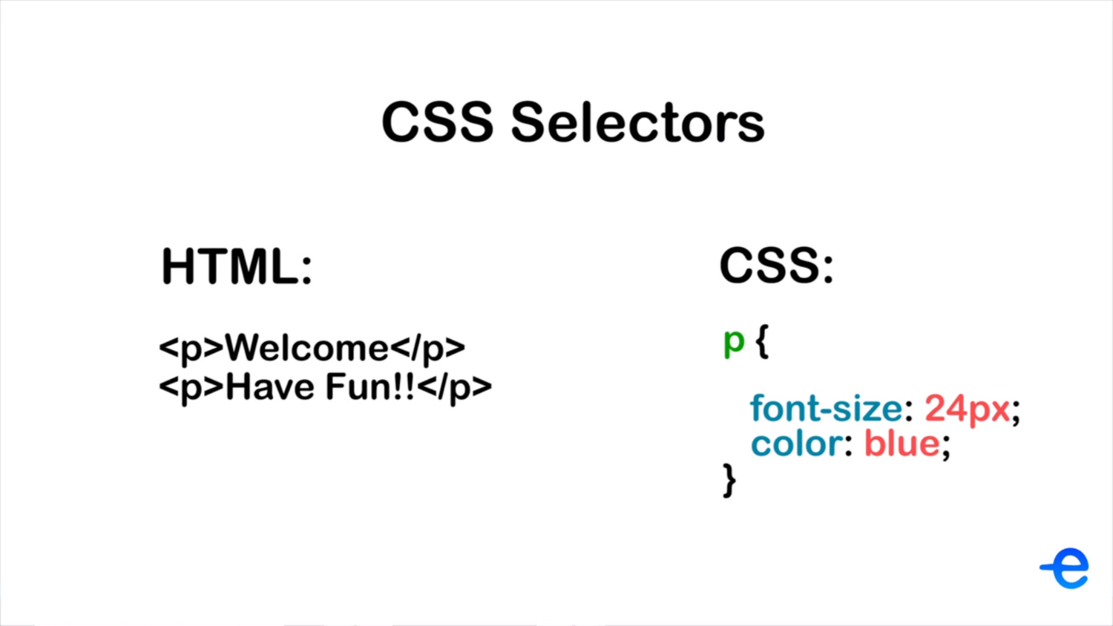

Slide 15
BASIC STYLING

Slide 16
Styling Text
Text Color: color
Text Alignment: text-align
Font Style: font-style (normal, italics)
Font Weight: font-weight (normal, bold, 100,..., 400, 500,..., 900 etc)
Text Decoration: text-decoration (overline, underline, line-through, none)
Text Transformation: text-transform (uppercase, lowercase, capitalize)
Letter Spacing: letter-spacing (Accepts both positive and negative values)
Word Spacing: word-spacing (Accepts both positive and negative values)
Line Height: line-height
Font Family: font-family

Slide 17
Adding Borders
Border Style: border-style (dotted, dashed, solid, double, none, mixed)
Border Width: border-width
Border Color: border-color
Shorthand Property:
border: 1px solid blue;
Rounded Corners: Border-Radius

Slide 18
Padding & Margin
Padding:
padding: 16px;
padding-top, right, bottom, left.
padding: 12px 16px 20px 24px
padding: 12px 24px 12px 24px; -> padding: 12px 24px;
Margin:
margin: 16px;
margin-top, right, bottom, left.
margin: 12px 16px 20px 24px
margin: 12px 24px 12px 24px; -> margin: 12px 24px;

Slide 19
Styling Buttons
We can use the general CSS properties like font-size, color, background-color, border etc to add styles to buttons.
We can also use the hover pseudo-class to add hover effects.
We can change the cursor to pointer.
Cursor: pointer, not-allowed, progress, grab, zoom-in, zoom-out.
Cursor Full Reference: https://www.w3schools.com/cssref/pr_class_cursor.asp

Slide 20
Adding Icons
There are few options to add icons:
We can use the <img /> tag to add icons.
We can use icon packs like Font Awesome or Material Icons.

Slide 21
Display Values
Display Values:
Block
Inline
Inline Block
None
Visibility:
Visible
Hidden

Slide 22
BOX MODEL

Slide 23
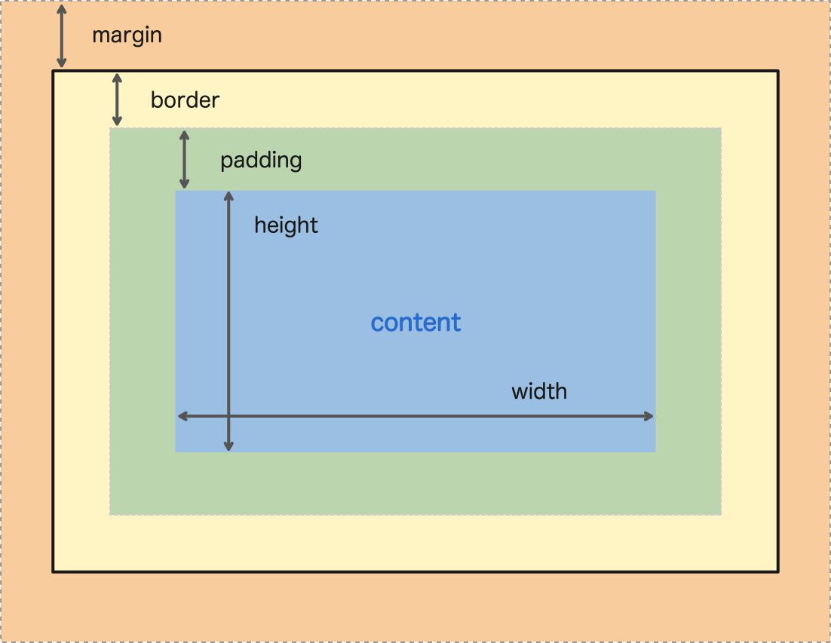

Slide 24
The “box-sizing” Property
box-sizing: border-box | content-box
The border-box value includes the padding and border in an element's total width and height.
The content-box value DOES NOT include the padding and border in an element's total width and height.

Slide 25
POSITION PROPERTY

Slide 26
The “position” Property
position : static | relative | absolute | fixed | sticky
static: default value. It shows elements in the normal order of the webpage.
relative: It positions HTML elements relative to their normal position.
absolute: It positions the HTML element, relative to the first parent element that has a position, other than static.
fixed: It positions the HTML element relative to the main HTML element and not to any other element.
sticky: It can be explained as a mix of position: relative and position: fixed. It behaves until a declared point like position: relative, after that it changes its behavior to position: fixed.

Slide 27
Handling Overflows
overflow: visible | hidden | scroll | auto
visible: Default Value. The content flows even outside the element's box.
hidden: The overflowing part of the content is clipped and is not visible on the screen.
scroll: The overflowing part of the content is clipped and scrollbar is added to view the clipped content.
auto: Same as overflow:scroll. It adds scrollbars only when the content is overflowing.

Slide 28
SHADOWS

Slide 29
Text Shadow
text-shadow: [horizontal-offset] [vertical-offset] [blur-radius] [color]
The default value for shadow color is the same as that of font color.
You can add multiple shadows by separating the values by comma.
For example,
text-shadow: 2px 2px 4px #0000ff

Slide 30
Box Shadow
box-shadow: [horizontal-offset] [vertical-offset] [blur-radius] [optional-spread-radius] [color]
The default value for shadow color is the same as that of font color.
You can add multiple shadows by separating the values by comma.

Slide 31
COMBINATORS

Slide 32
Different Combinators
There are four different combinators in CSS:
Descendant Selector (space)
Child Selector (>)
Adjacent Sibling Selector (+)
General Sibling Selector (~)

Slide 33
Descendant Selector
Syntax: selector_a selector_b
The space in between selectors is the Descendant selector.
The descendant selector, will select all the elements matching selector_b which are DESCENDANTS of the elements matching selector_a

Slide 34
Child Selector
Syntax: selector_a > selector_b
This greater than sign is the Child Selector.
The child selector, will select all the elements matching selector_b which are DIRECT CHILD of the elements matching selector_a

Slide 35
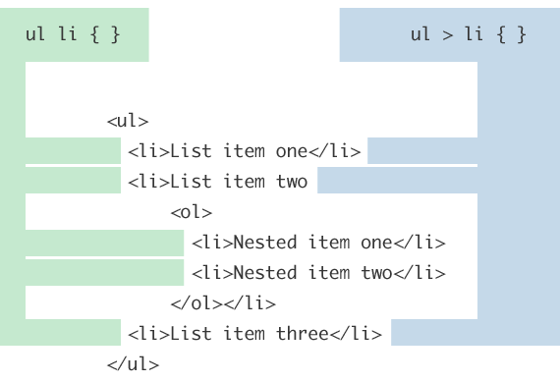

Slide 36
Adjacent Sibling Selector
Syntax: selector_a + selector_b
The plus sign is the Adjacent sibling selector.
An adjacent sibling selector allows you to select an element that is directly after another specific element i.e, if selector_b is an immediate sibling of selector_a.
NOTE: Siblings are the elements which have the same parent element and come after the target element.

Slide 37
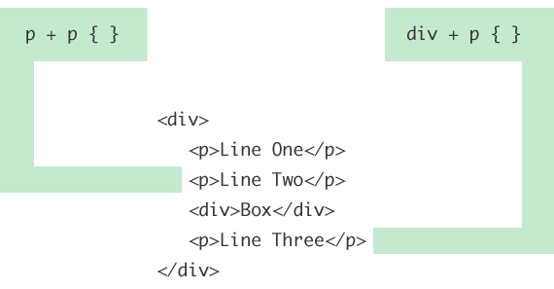

Slide 38
General Sibling Selector
Syntax: selector_a ~ selector_b
The tilde sign is the General sibling selector.
The General Sibling selector is very much like Adjacent Sibling Selector. The only difference is that all the siblings are selected rather than just the immediate one.
NOTE: Siblings are the elements which have the same parent element and come after the target element.

Slide 39
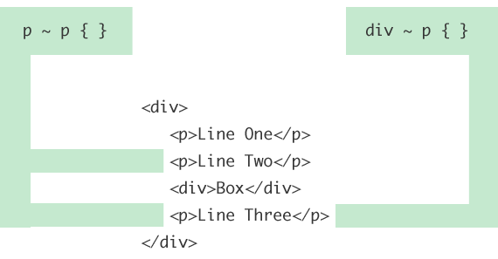

Slide 40
Combinators Summary
It saves you from writing tons of extra classes and IDs.
You can select child elements using the parent elements. For eg, the drop down.
You should not just use combinators and you should not just add classes and IDs. You need to find a balance between both.

Slide 41
BACKGROUNDS

Slide 42
Background Properties
These are the background related properties:
background-color: Accepts a color value.
background-image: Accepts a url for the image location -> url(“”)
background-repeat: repeat(default) | repeat-x | repeat-y | no-repeat.
background-position: left top right bottom center (Combination of two) | % | px
background-size: auto(default, uses original size) | dimensions | cover( fills the space) | contain(makes full image visible)
background-attachment: scroll(default) | fixed

Slide 43
GRADIENTS

Slide 44


Slide 45
Gradient: Linear
In the linear gradient the color transition is linear i.e, it can go either up, down, left, right or diagonal.
Syntax:
background-image: linear-gradient(angle, color-1, color-2, ...)
Angle: to bottom | to top | to left | to right | angle in deg.
Color: Hex, RGB, RGBA

Slide 46
Gradient: Radial
In radial gradient the color transition is circular. It looks like rings of different color.
Syntax:
background-image: radial-gradient([shape] [size] [at position], start-color, ..., last-color);
Shape: circle | ellipse(default).
Size: closest-side | farthest-side | closest-corner | farthest-corner(default).
Position: at top left right bottom center (combination of two) center center(default).
Color: Hex, RGB, RGBA

Slide 47
TEXT EFFECTS

Slide 48
Text Flow Related Properties
white-space: normal(default) | nowrap | pre(acts as <pre> tag)
text-overflow: clip | ellipsis
Note: For clip|ellipsis to work you need to add the following two properties:
white-space: nowrap;
overflow: hidden;

Slide 49
FLEX BOX

Slide 50
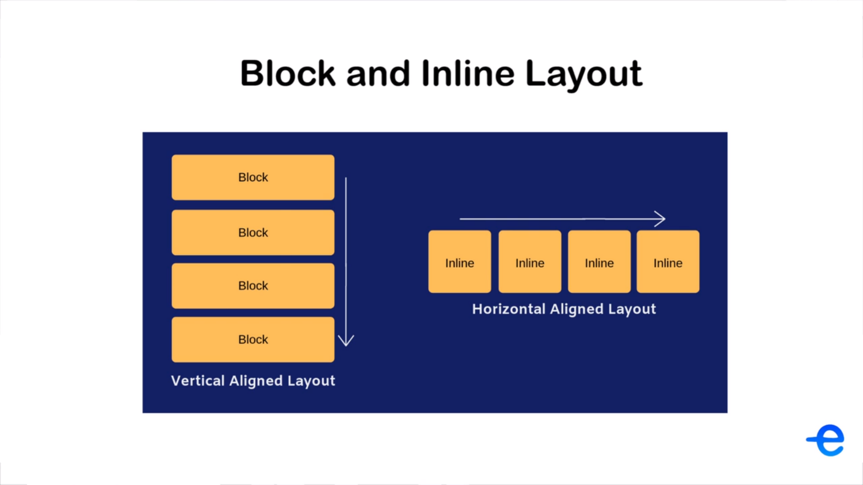

Slide 51
Flex Layout
The flex layout gives container the ability to alter it’s items' width and height to best fill the available space.
A flex container expands items to fill available free space, or shrinks them to prevent overflow. This makes it perfect for designing layouts for which the size is unknown or flexible.
Block elements layout vertically, Inline elements layout horizontally but Flex can create layouts both horizontal and vertical based on certain properties.

Slide 52
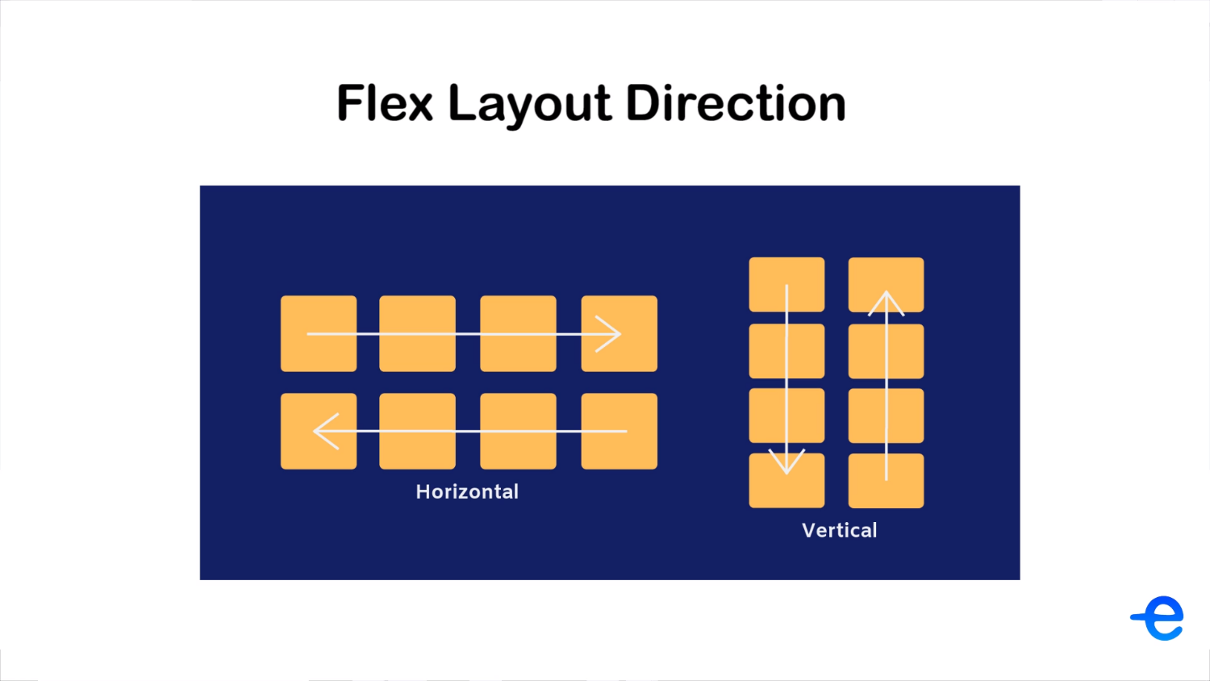

Slide 53
Flex Properties
These are some of the properties:
Display Value - flex | inline-flex
Flex Direction - row | row-reverse | column | column-reverse
Main Axis and Cross Axis
Flex Start and Flex End
Justify-Content: flex-start | flex-end | center | space-between | space-around | space-evenly. //align elements along the main axis
Flex Wrap: wrap | nowrap | wrap-reverse.
Align Items: stretch | flex-start | flex-end | center | baseline.
Align Content(When multiple rows/columns): flex-start | flex-end | center | space-between | space-around | stretch.

Slide 54
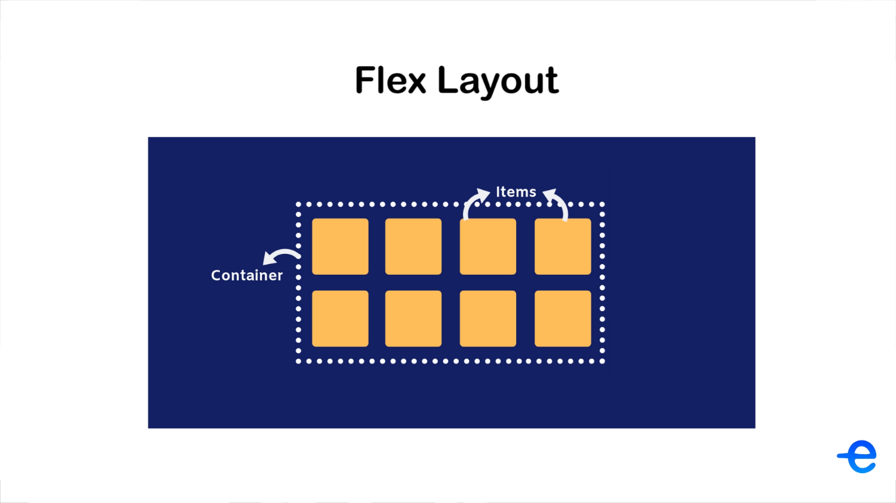

Slide 55
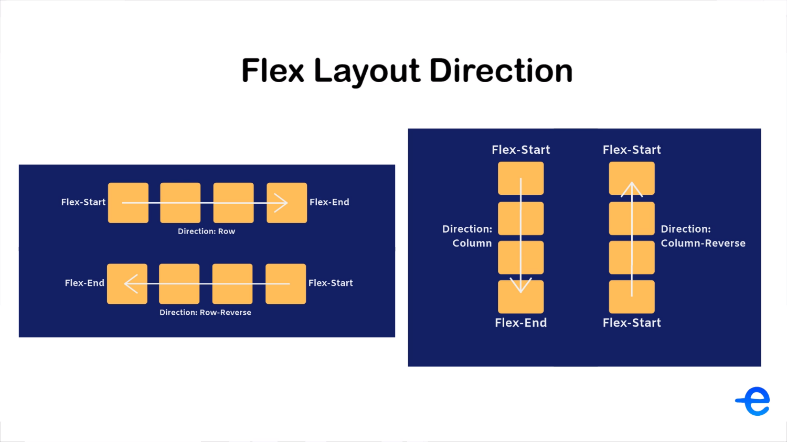

Slide 56
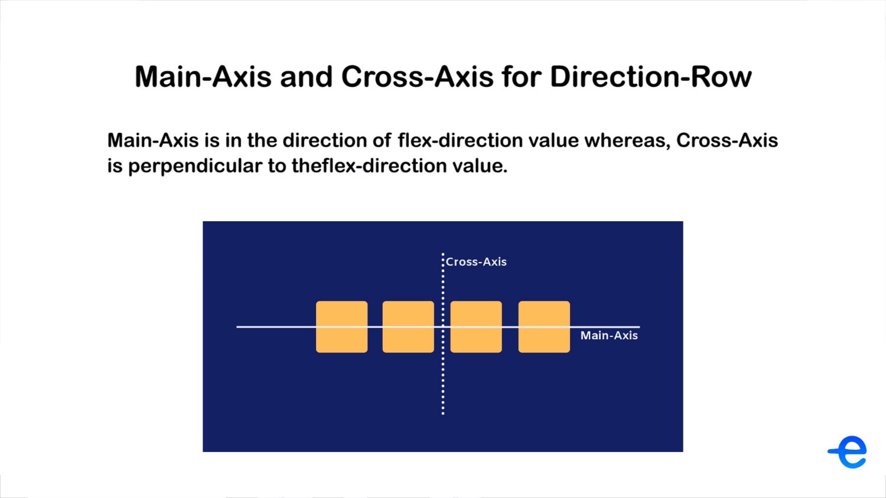

Slide 58
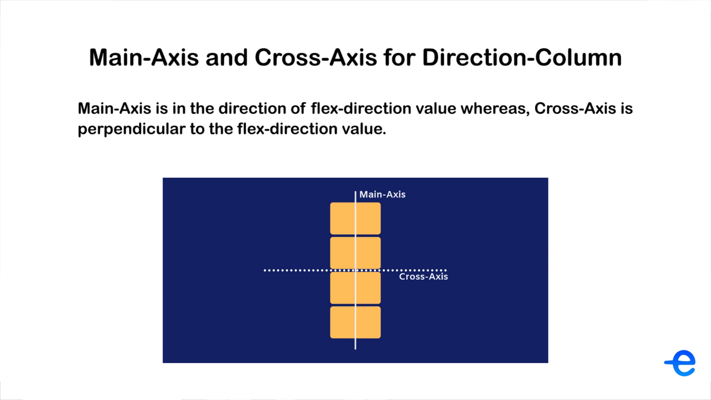

Slide 59
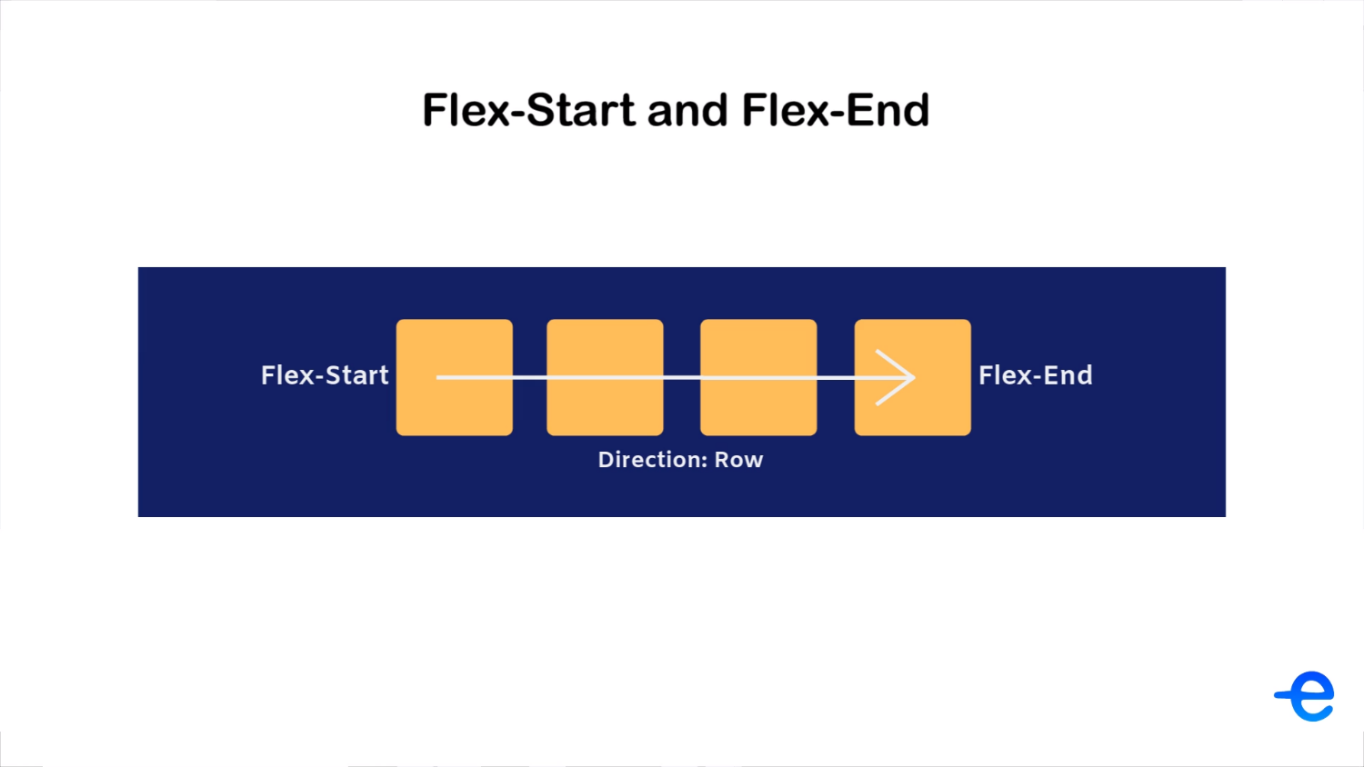

Slide 60
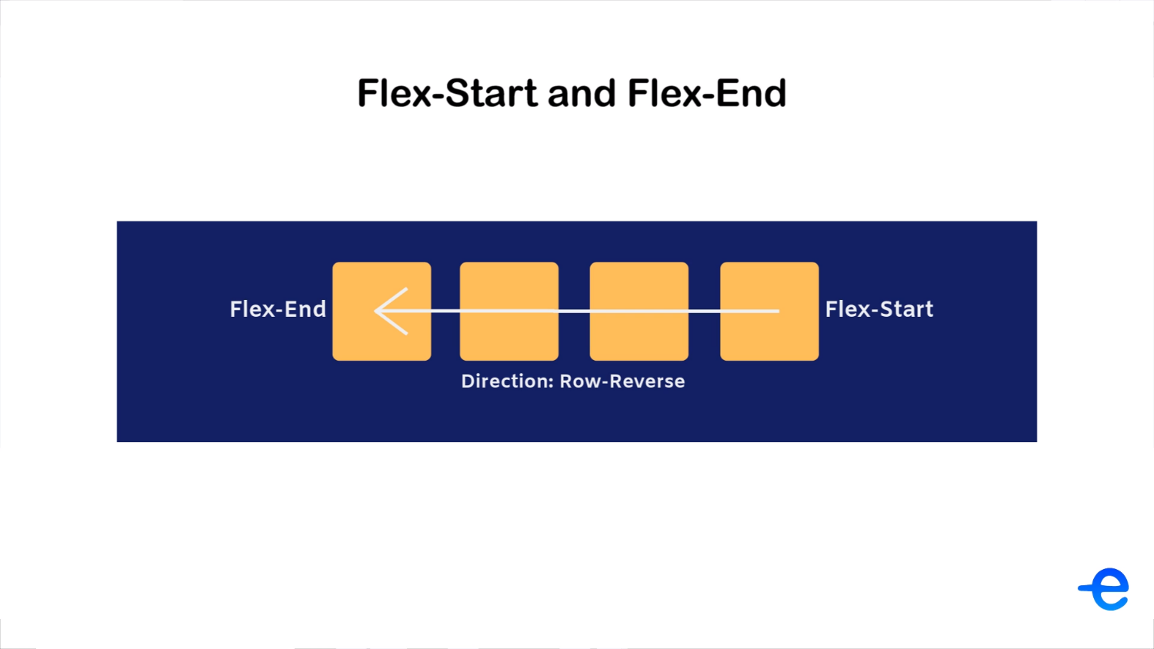

Slide 61
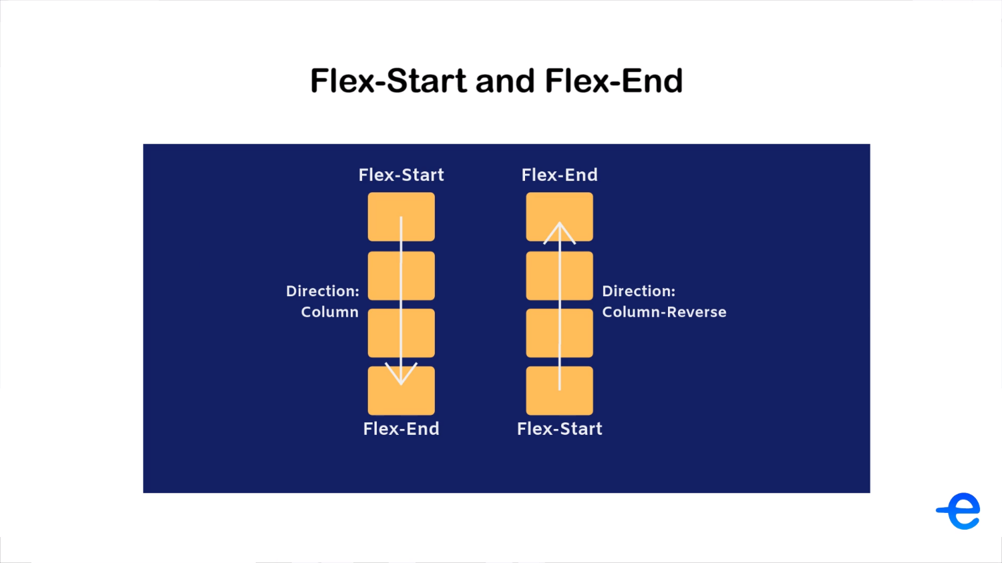

Slide 62
TRANSFORMS

Slide 63
The “transform” Property
The transform property gives access to following functions:
Translate: translate(x, y), translateX(), translateY(). Give values in px or %.
Scale: scale(width-factor, height-factor), scaleX(), scaleY()
Skew(Tilt): skeyX() and skewY(). Give an angle (+ve or -ve) in degrees. No shorthand property.
Rotate: rotate(), rotateX(), rotateY(), rotateZ(). Give an angle (+ve or -ve) in degrees.
NOTE: You can add multiple functions to the same transform property. Just separate them by a space.

Slide 64
TRANSITIONS

Slide 65
The “transition” Property
The transition property allows elements to change value over a specified time period rather than immediately which creates an animation effect.
transition: [transition-property] [transition-duration] [transition-timing-function] [transition-delay];
transition-property: all or specific property name. Can also give multiple values separated by comma.
transition-duration: sets the total time for transition. It accepts a value in “s” or “ms”.
transition-timing-function: linear | ease(default: slow-fast-slow) | ease-in(start slow) | ease-out(end slow) | ease-in-out(slow-fast-slow) | cubic-bezier(x1, y1, x2, y2)
transition-delay: adds a delay. It accepts a value in “s” or “ms”.

Slide 66
ANIMATIONS

Slide 67
The “animation” Property
Each animation needs to be defined with the @keyframes rule which is then called with the animation property.
@keyframes keyframe-name {
0% {
css-property-name: value;
}
25% {
css-property-name: value;
}
100% {
css-property-name: value;
}
}

Slide 68
The “animation” Property
animation-duration: Time to complete one cycle. Value to be in “s” or “ms”.
animation-iteration-count: Number of cycles? Value to be a number or infinite.
animation-direction: normal | alternate(0->100 then 100->0) | reverse(100->0 then 100->0).
animation-timing-function: ease-in | ease-out | ease-in-out | linear | bezier-curve()
animation-fill-mode: backwards | forwards;
animation-delay: Value to be in “s” or “ms”.
animation-play-state: paused | running.

Slide 69
The “animation” Property
animation: keyframe-name | animation-duration | animation-timing-function | animation-delay | animation-iteration-count | animation-direction | animation-fill-mode | animation-play-state;

Slide 70
The “cubic-bezier()” function
The cubic-bezier() function of CSS is used to generate a cubic bezier curve for Progression vs Time.
Syntax: cubic-bezier(x1, y1, x2, y2);
Where,
x1, y1 represent P1.
x2, y2 represent P2.

Slide 71
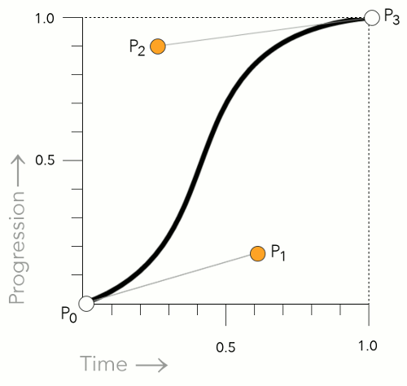

Slide 72
PSEUDO CLASSES

Slide 73
Pseudo Classes
A pseudo-class is used to access different states of HTML elements.
For example,
#btn:hover {}
.menu-items:active {}
This :something is called a pseudo class.

Slide 74
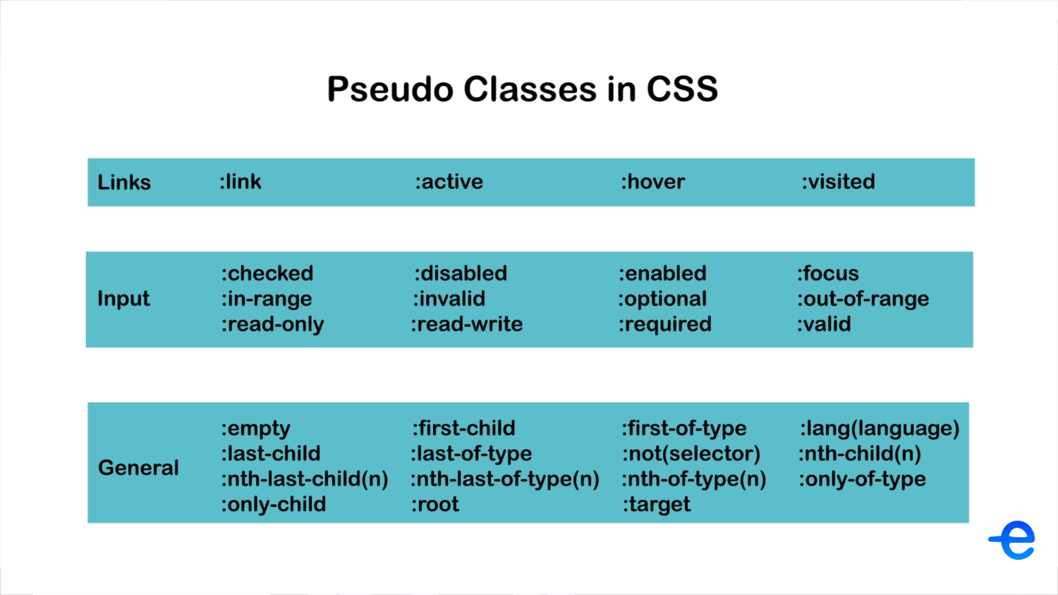
Notes:
https://developer.mozilla.org/en-US/docs/Web/CSS/Pseudo-classes

Slide 75
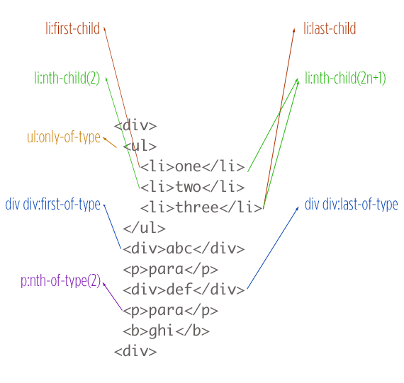
Notes:
https://developer.mozilla.org/en-US/docs/Web/CSS/Pseudo-classes

Slide 76
PSEUDO ELEMENTS

Slide 77
Pseudo Elements
A CSS pseudo-element is used to style specific parts of an HTML element.
These are some of the pseudo elements:
::first-line
::first-letter
::selection
::after
::before
::placeholder
::scrollbars

Slide 78
Vendor Prefixes
Some browsers require vendor prefixes for certain properties. The purpose of a vendor prefix is to allow browsers to support newer CSS features before that feature is fully supported by the browser.
Common prefixes you’ll see and the browsers they go with:
-webkit- Used by Chrome, Safari, Android, & iOS
-moz- Used by Mozilla Firefox
-o- Used by Opera
-ms- Used by Internet Explorer and Edge.

Slide 79
The “::scrollbar” Pseudo-Element
It is used to customize the scrollbars.
NOTE: It is only supported in webkit browsers which are Chrome, Safari, Android and iOS.
/* width */
::-webkit-scrollbar {
width: 10px;
}
/* Track */
::-webkit-scrollbar-track {
background: #f1f1f1;
}

Slide 80
The “::scrollbar” Pseudo-Element
/* Handle */
::-webkit-scrollbar-thumb {
background: #888;
}
/* Handle on hover */
::-webkit-scrollbar-thumb:hover {
background: #555;
}

Slide 81
RESPONSIVE DESIGN

Slide 82


Slide 83


Slide 84
Responsive Design
“Responsive design” refers to the idea that your website should display equally well in all screen sizes from widescreen monitors to mobile phones. It’s an approach to web design and development that eliminates the distinction between the mobile-friendly version of your website and its desktop counterpart.
This saves you a lot development time, so instead of maintaining one website for smartphones and an entirely different site for laptops/desktops, you can use the same HTML code for both of them.

Slide 85
Viewport
The viewport is the user's visible area of a web page. It varies with the device, and will be smaller on a mobile phone than on a computer screen.
The foll meta tag needs to be added to all the websites which are to be mobile responsive.
<meta name="viewport" content="width=device-width, initial-scale=1.0">
Dimensions: viewport-width(vw) and viewport-height(vh).

Slide 86
Dynamic Dimensions
Use percentage, vw and vh rather than fixed values.
Using max-width and max-height property.

Slide 87
MEDIA QUERIES

Slide 88
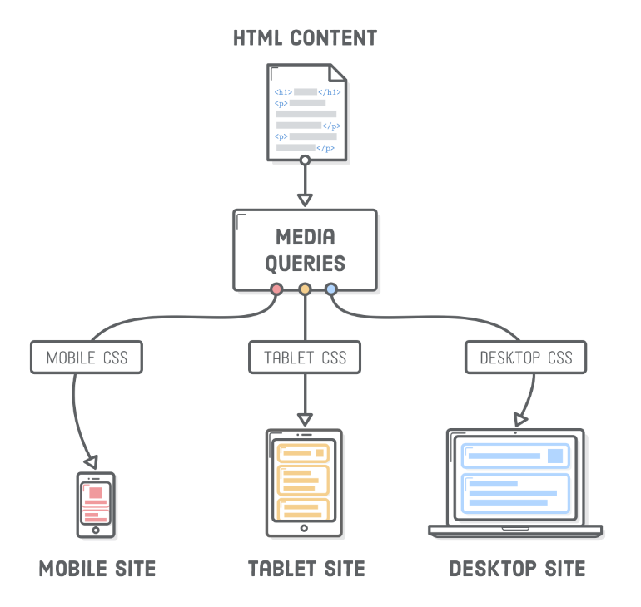
Media Queries
for Responsive Design

Slide 89
Media Queries
Syntax:
@media (max-width: 400px) {
css-selector {
background-color: lightblue;
}
}

Slide 90
Standard Breakpoints
/* Extra small devices (phones, 600px and down) */
@media (max-width: 600px) {...}
/* Small devices (portrait tablets and large phones, 600px and up) */
@media (min-width: 600px) {...}
/* Medium devices (landscape tablets, 768px and up) */
@media (min-width: 768px) {...}
/* Large devices (laptops/desktops, 992px and up) */
@media (min-width: 992px) {...}
/* Extra large devices (large laptops and desktops, 1200px and up) */
@media (min-width: 1200px) {...}

Slide 91
UNITS

Slide 92
Units
There are 2 types of units:
Absolute: These are fixed and do not scale based on parent or window size For example, px
Relative: These are useful for styling responsive sites because they scale relative to the parent or window size (depending on the unit).
For example, %, em, rem, vh, vw;

Slide 93
QUIZ TIME

Slide 94
Quiz-3 : CSS Basics
The quiz has 10 Questions (2 marks each)
Total time for Quiz is 15 minutes.
Quiz Link: https://forms.gle/UzTfisc1r5GmLq1j9

Slide 95
GRID LAYOUT

Slide 96
Grid Layout
So far we have used tables, floats, position properties and inline-block to design and structure our layouts, but all of these methods were more like hacks.
Flex helped creating layouts, but it's intended for simpler one-dimensional layouts, not complex two-dimensional ones.
Grid is the very first CSS module created specifically to solve the layout problems. The Grid Layout offers a grid-based layout system, with rows and columns, making it easier to design web pages.

Slide 97
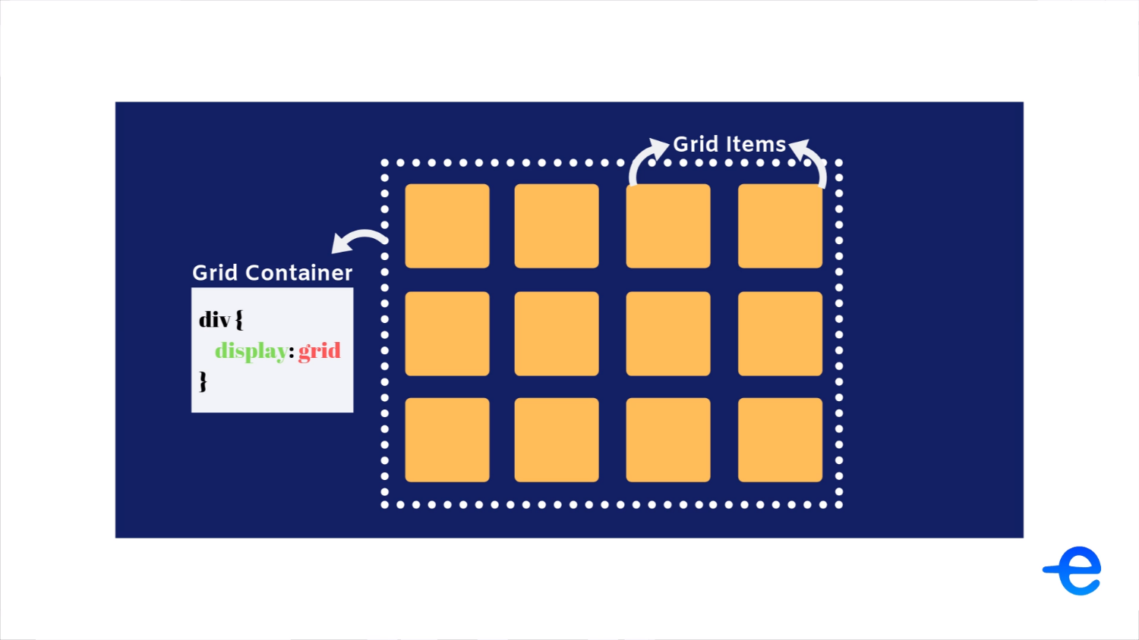

Slide 98
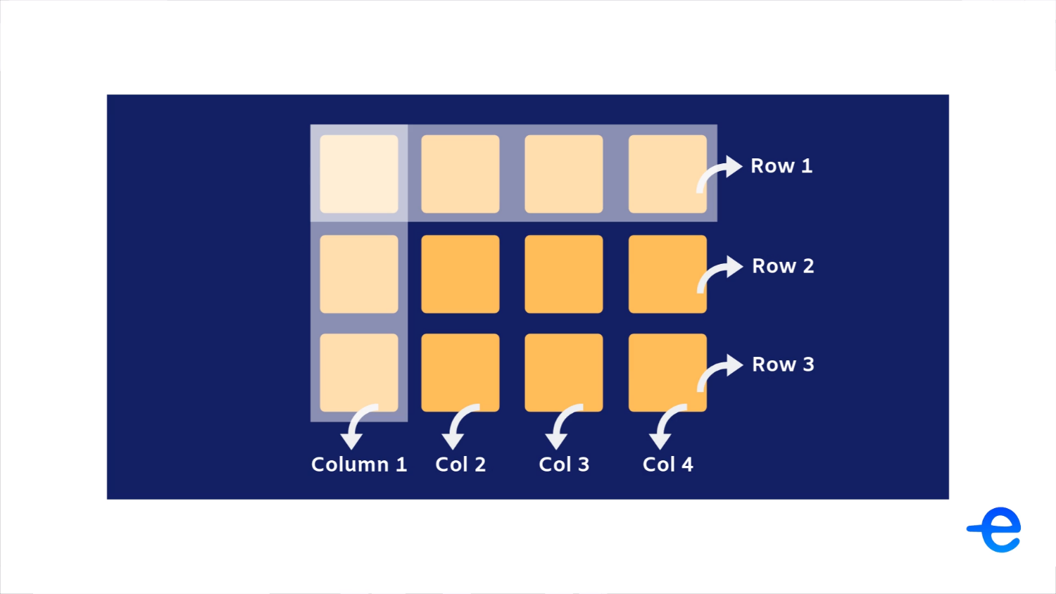

Slide 99
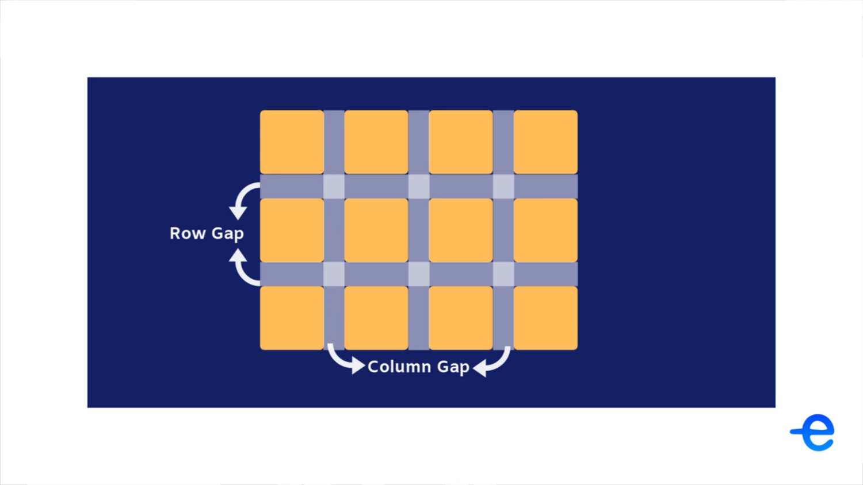

Slide 100
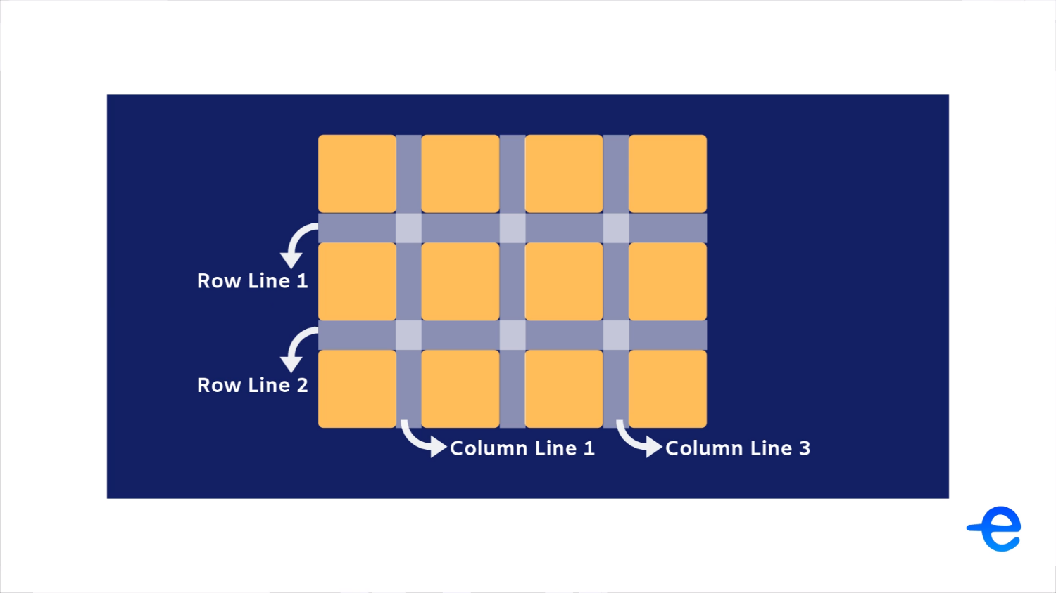

Slide 101
Grid Properties
display: grid | inline-grid
grid-template-columns: width for columns(px, %, auto, fr)
grid-template-rows: height of rows(px, %, auto, fr)
grid-template-areas + grid-area;
grid-row-gap/grid-column-gap/grid-gap;
justify-items: start | end | center | stretch;
justify-content: start | end | center | stretch | space-around | space-between | space-evenly;
align-items: start | end | center | stretch;
align-content: start | end | center | stretch | space-around | space-between | space-evenly;

Slide 102
KEEP LEARNING!!

